Slide 1
How to Sort Smart & Recycle RIght!
School Name Here

Slide 2
Let's talk about waste!
Waste is something that is thrown away because we no longer find it useful.
Notes:
Let’s talk about waste…
Waste is something that we throw away because we no longer see it as useful, but waste is also the action of throwing something away, unncessarily--something that still had use, but was instead put into the trash can. (Share personal experiences if you want.)
Examples of waste: broken pencil, wrappers, and this can even be food leftover on our trays. In fact the amount of food we waste in the United States is staggering. Here are some important facts…

Slide 3
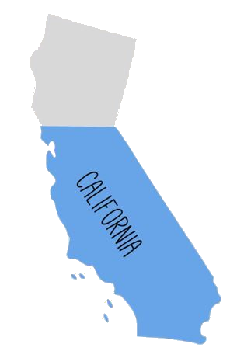
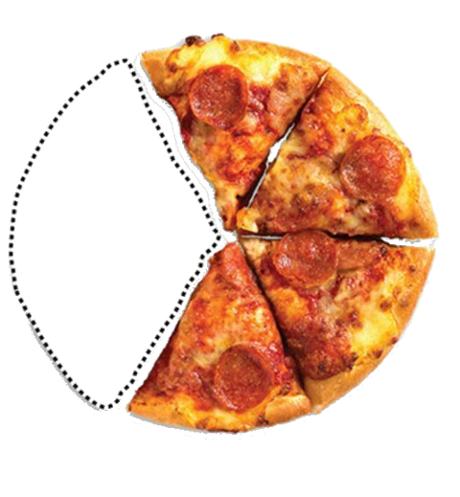
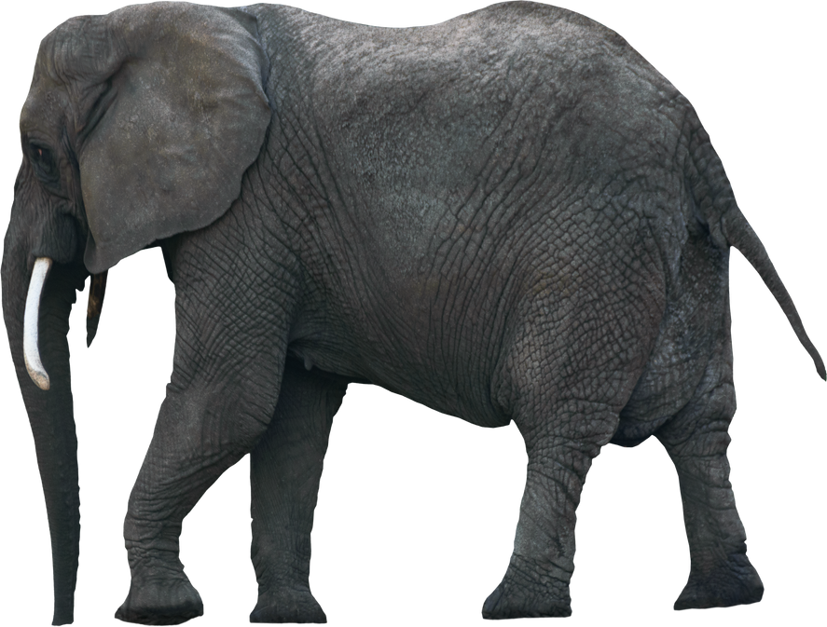
We waste 108 billion pounds of food!
30-40%
of our food is wasted
9 million African Elephants
3/4 the size of California
Notes:
In the United States, we waste 108 billion pounds of food every year. 108 billion is such a huge number and can be hard to visualize what that looks like, but think of it this way:
(Click to appear) We are wasting 30-40% of the food produced in the United States each year. That’s like buying yourself a whole pizza, only eating three slices and throwing away almost half of it into the trash.
(Click to appear) If we were to grow all of the food we waste on one farmland, that farmland would take up 3/4th of California.
(Click to appear) To add more weight, 108 billion pounds of food waste equals about 9 million African Elephants.
As you can see, the amount of food waste is alarming and it is a big problem in the United States.
Where do you think our food ends up after we throw it away?

Slide 4
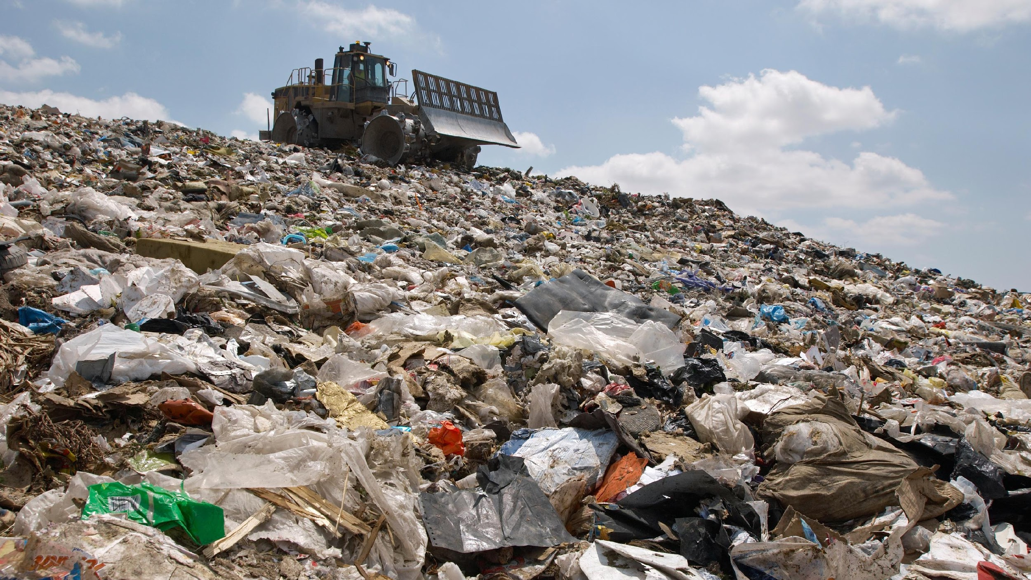
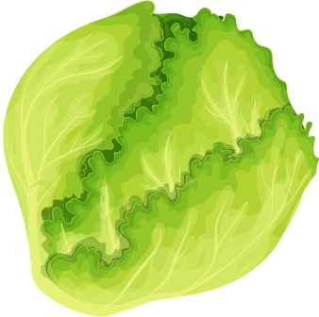
Landfill
METHANE
A head of lettuce can take 25 years to rot or decompose.
Notes:
Most of the food we throw away ends up here, in the landfill. A landfill is a place where we bury our waste in the ground.
Landfills are very compact and airtight, which means there is not a lot of oxygen inside them. Just like how oxygen is an essential ingredient to sustain life, and it’s also essential for helping our waste breakdown or decompose. Because of this, it can take decades for our food waste to disappear in a landfill.
(Click to reveal fact as you name it.) A head of lettuce can take 25 years to decompose.
As the food waste slowly rots, it releases a greenhouse gas called Methane. (Click to reveal Methane Monster.) Greenhouse gases trap heat in our atmosphere, and methane traps A LOT of heat, which causes climate change and global warming.

Slide 5
What we can do with food instead of sending it to the landfill:
Feed Yourself
2. Save for Later
3. Feed the Soil
Notes:
The most important thing we can do to stop food waste from going to the landfill is to not create it in the first place. But there are also better things we can do with the food we don’t want instead of throwing it in the trash. Those things are:
Feed yourself by only taking food that you know you can eat and by saving leftovers for later.
Save for later. For example, if you have a bag of chips or carrots, put them in your backpack for a snack later.
If you can’t do either of these options, the next best step is to feed the soil!

Slide 6
Feed the soil with...
COMPOST!
Notes:
And we can feed the soil with… (click to reveal.) Compost!

Slide 7
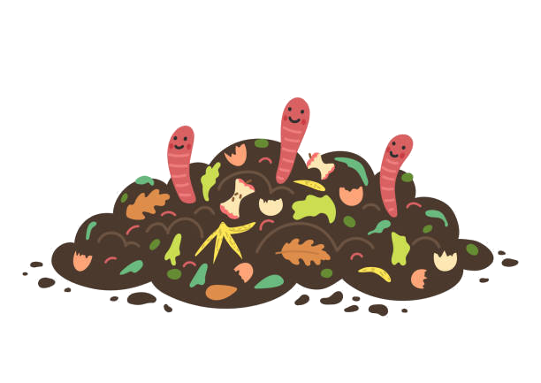
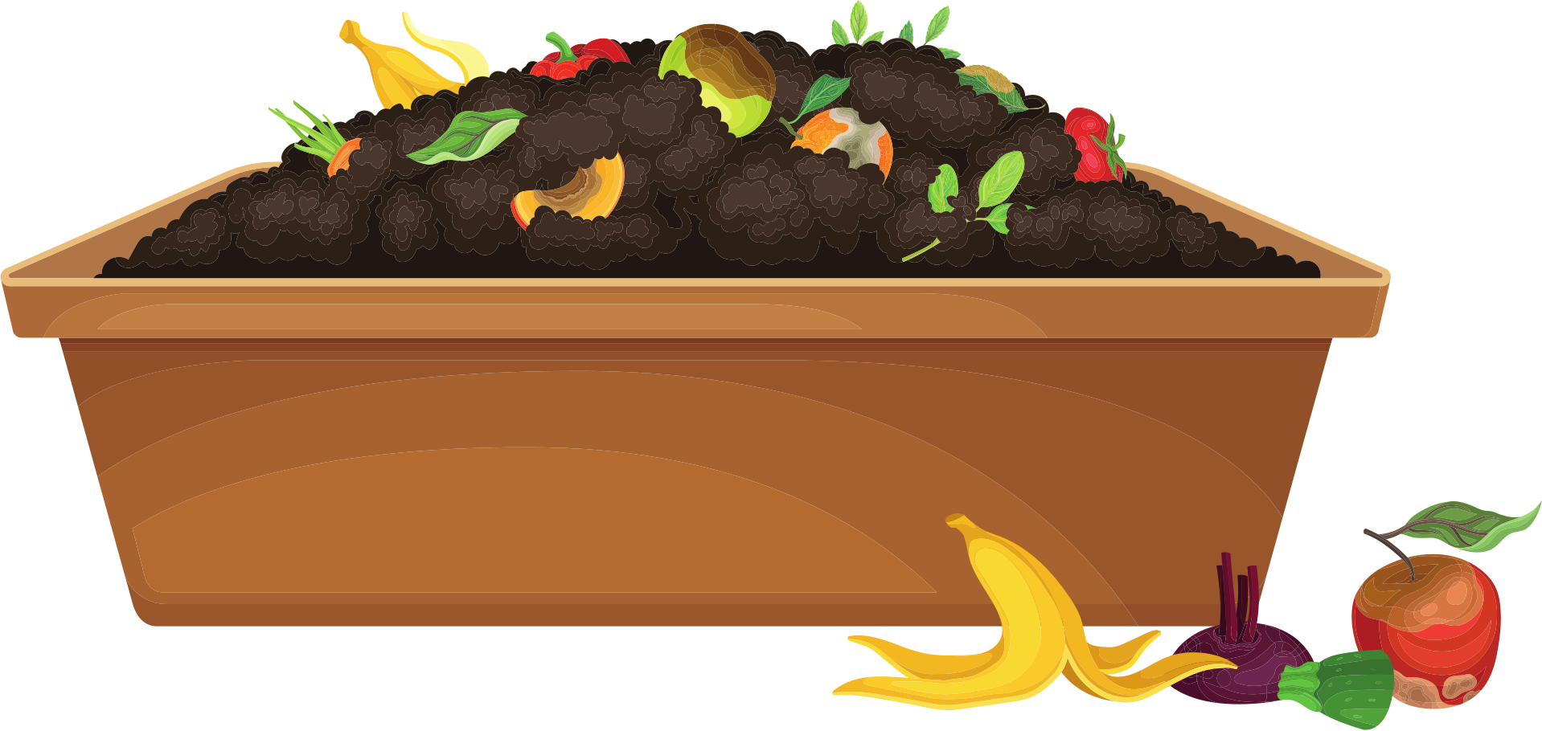
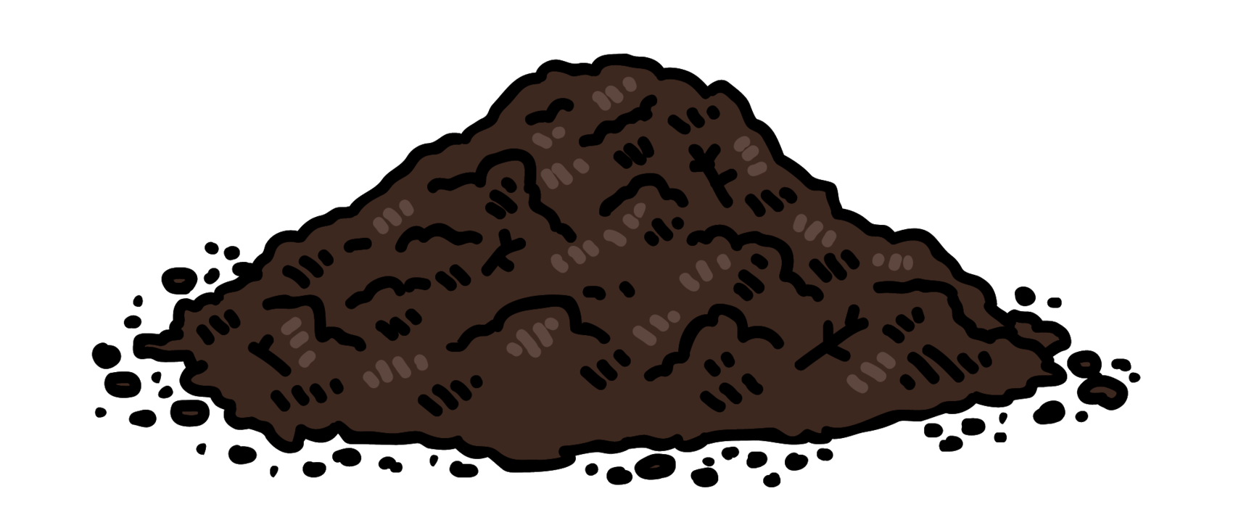
What's compost?
Tiny critters break down the food, turning it into compost
Compost is full of nutrients that feeds the soil
Healthy soil = more food grown!
Notes:
What’s compost?
Instead of throwing food waste into the trash can, it can go into a different can to be sent to a compost pile. As the food in a compost pile breaks down with help from tiny critters, like worms, the nutrients from the food is recycled into an excellent fertilizer for gardens. Just like how humans need water and nutrients to live, our soil does too! We can use compost to feed the soil so we can keep growing food to eat!
Composting our food waste helps us reduce our waste in landfills, reduce greenhouse gases in the air, and helps us create healthy soil for gardens!

Slide 8
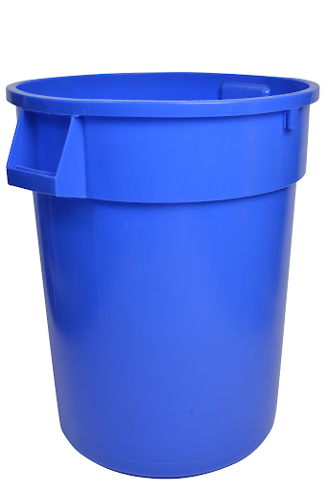
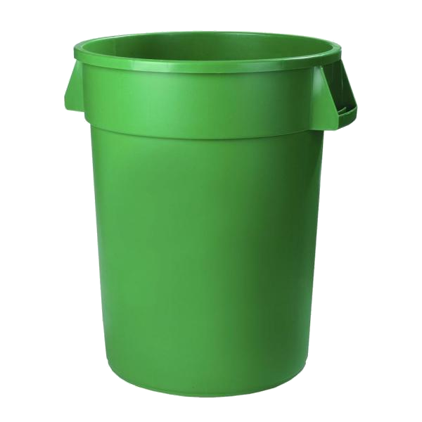
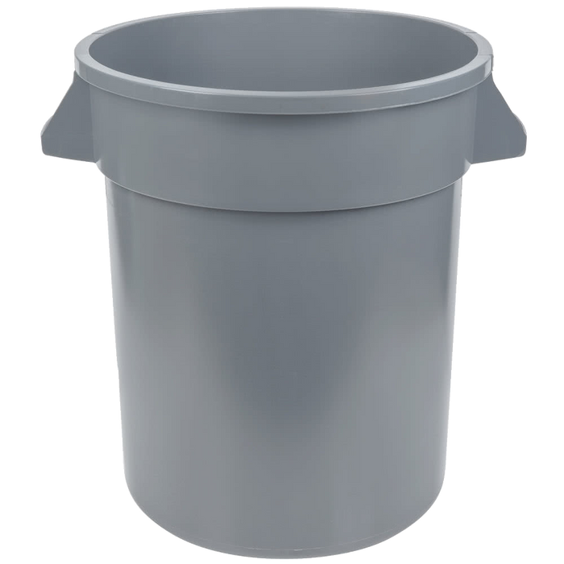
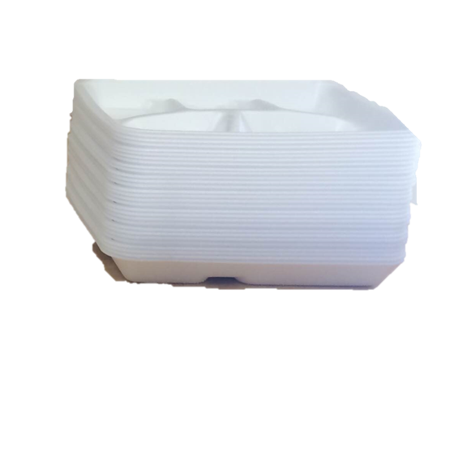
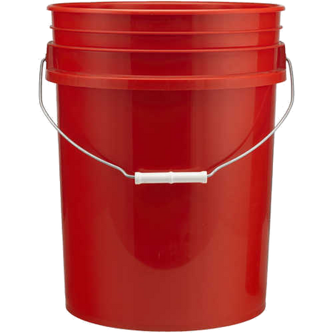
FIVE STEPS to Sort Smart:
Food Scraps
Landfill
Recycle
Liquids
Stack Your Tray
1
2
3
4
5
Notes:
Your school wants to help fight food waste and reduce waste in landfills by starting a food waste recycling program.
In the cafeteria, you will see new cans called “Waste Stations” to sort you waste into different containers so the food waste can be collected for compost.
The waste stations have four steps:
Liquids
Landfill
Recycle
Food Waste

Slide 9
Step 1: Empty Liquids
Opened containers ONLY
Notes:
Step 1 - Empty your liquids into the bucket.

Slide 10
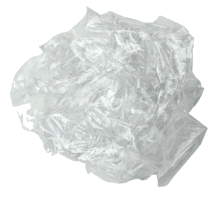
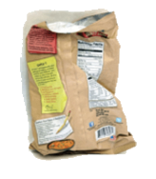
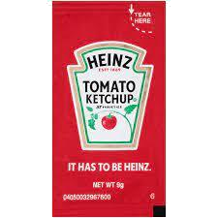
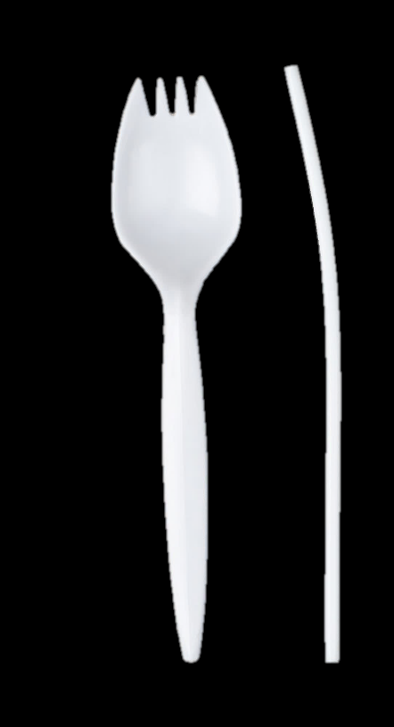
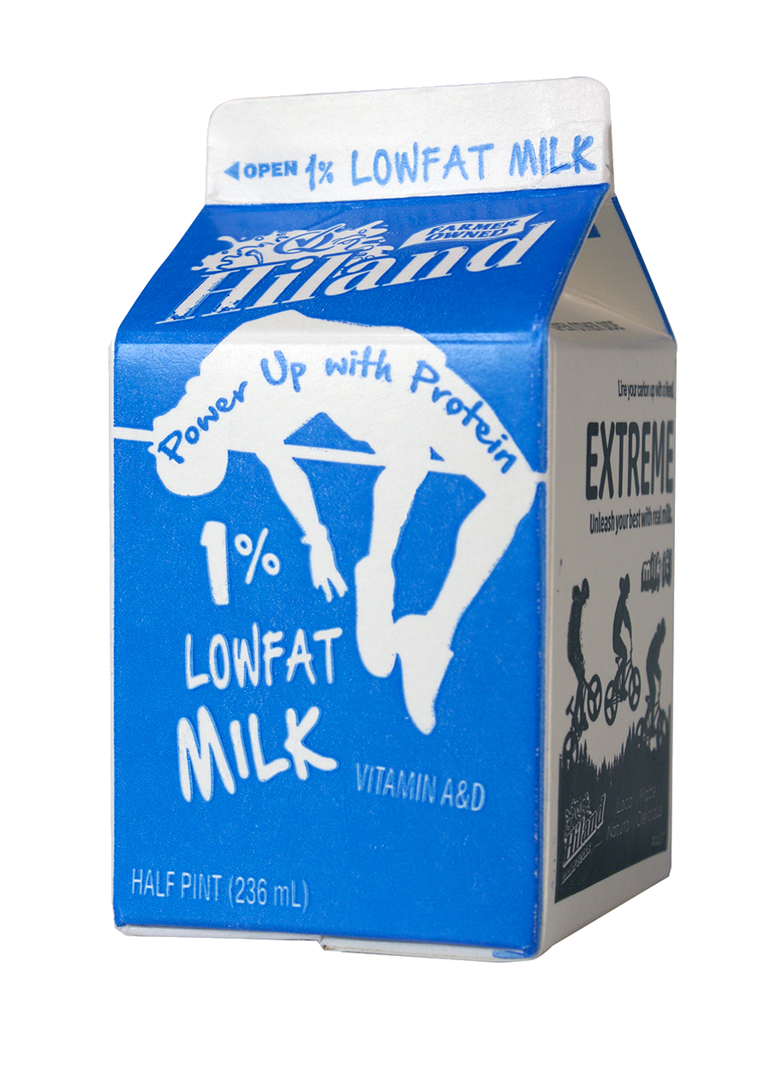
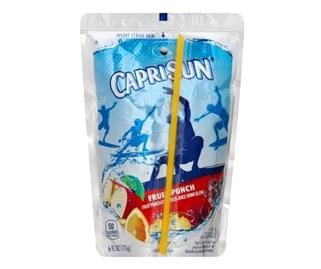
Step 2: Landfill Waste in GRAY CAN
Flimsy Plastics
Food Wrappers
Landfill
Plastic Utensils and Straws
Milk & Juice Cartons
Notes:
Step 2 – In general, if it isn’t food and isn’t recyclable then it will go into the GRAY can. This also includes recyclable items ONLY IF they are dirty.
Examples of trash are:
Plastic utensils & straws, filmsly plastics such as plastic wrap and zip lock bag
Milk cartons & juice boxes
Food wrappers, including sauce packets
Napkins and paper towels

Slide 11
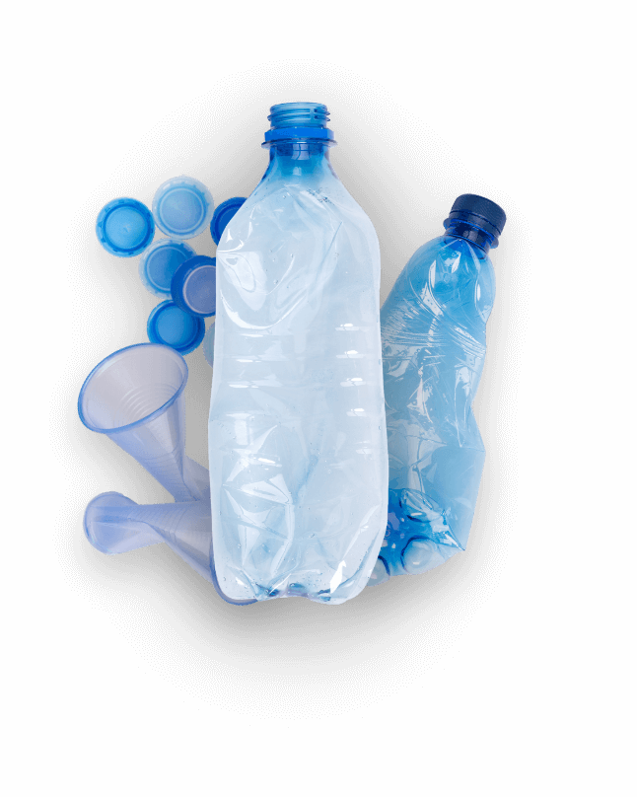
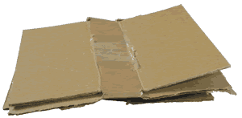
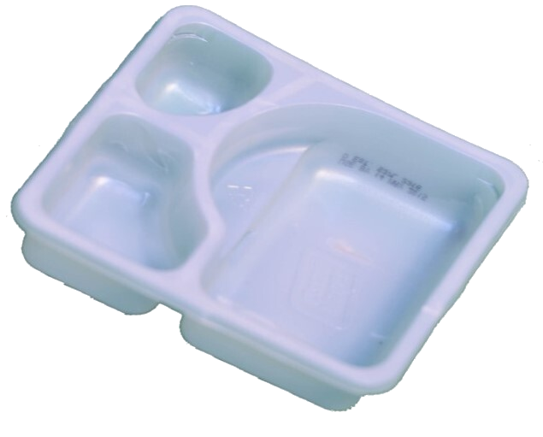
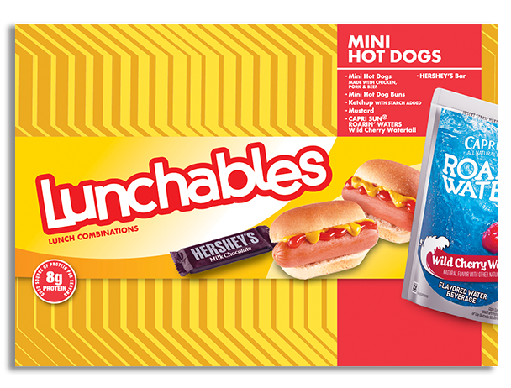
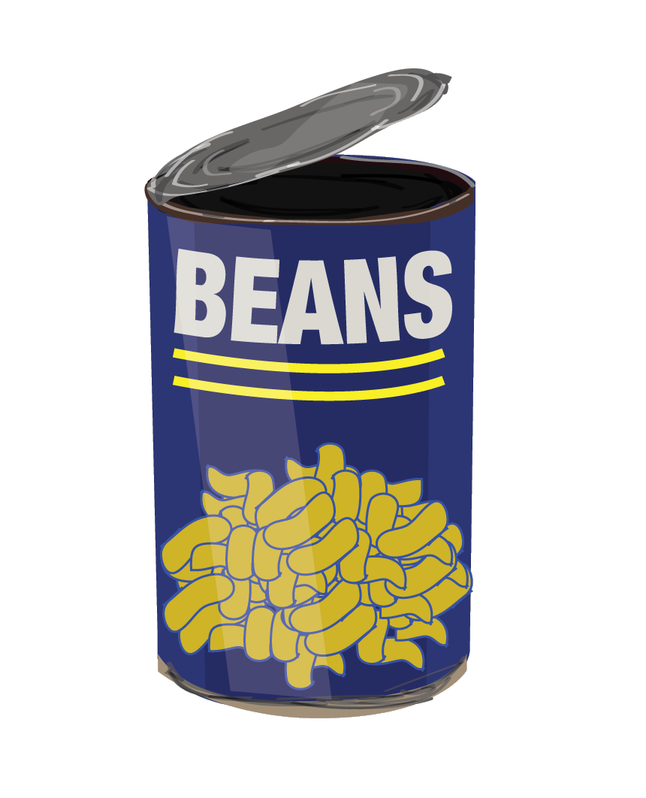
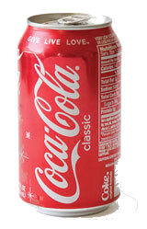
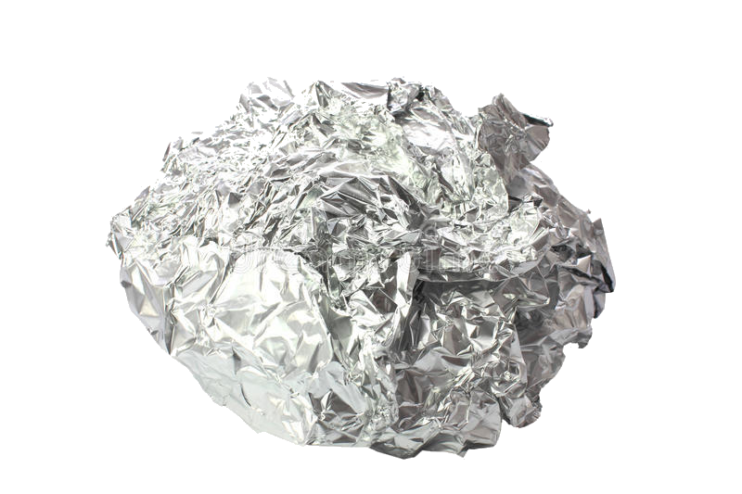
Step 3: Recycling in BLUE CAN
Clean & Dry
Firm Plastics
Clean Cardboard
Recycle
Aluminum & Metals
Notes:
Step 3 – Toss recyclables in the BLUE can. This includes clean items like:
CLEAN cardboard (such as a lunchbox)
Clean aluminum & metals Empty plastic water bottles
Clean and firm plastics (if the plastic is hard and cannot be torn easily, it can go into the recycling can)

Slide 12
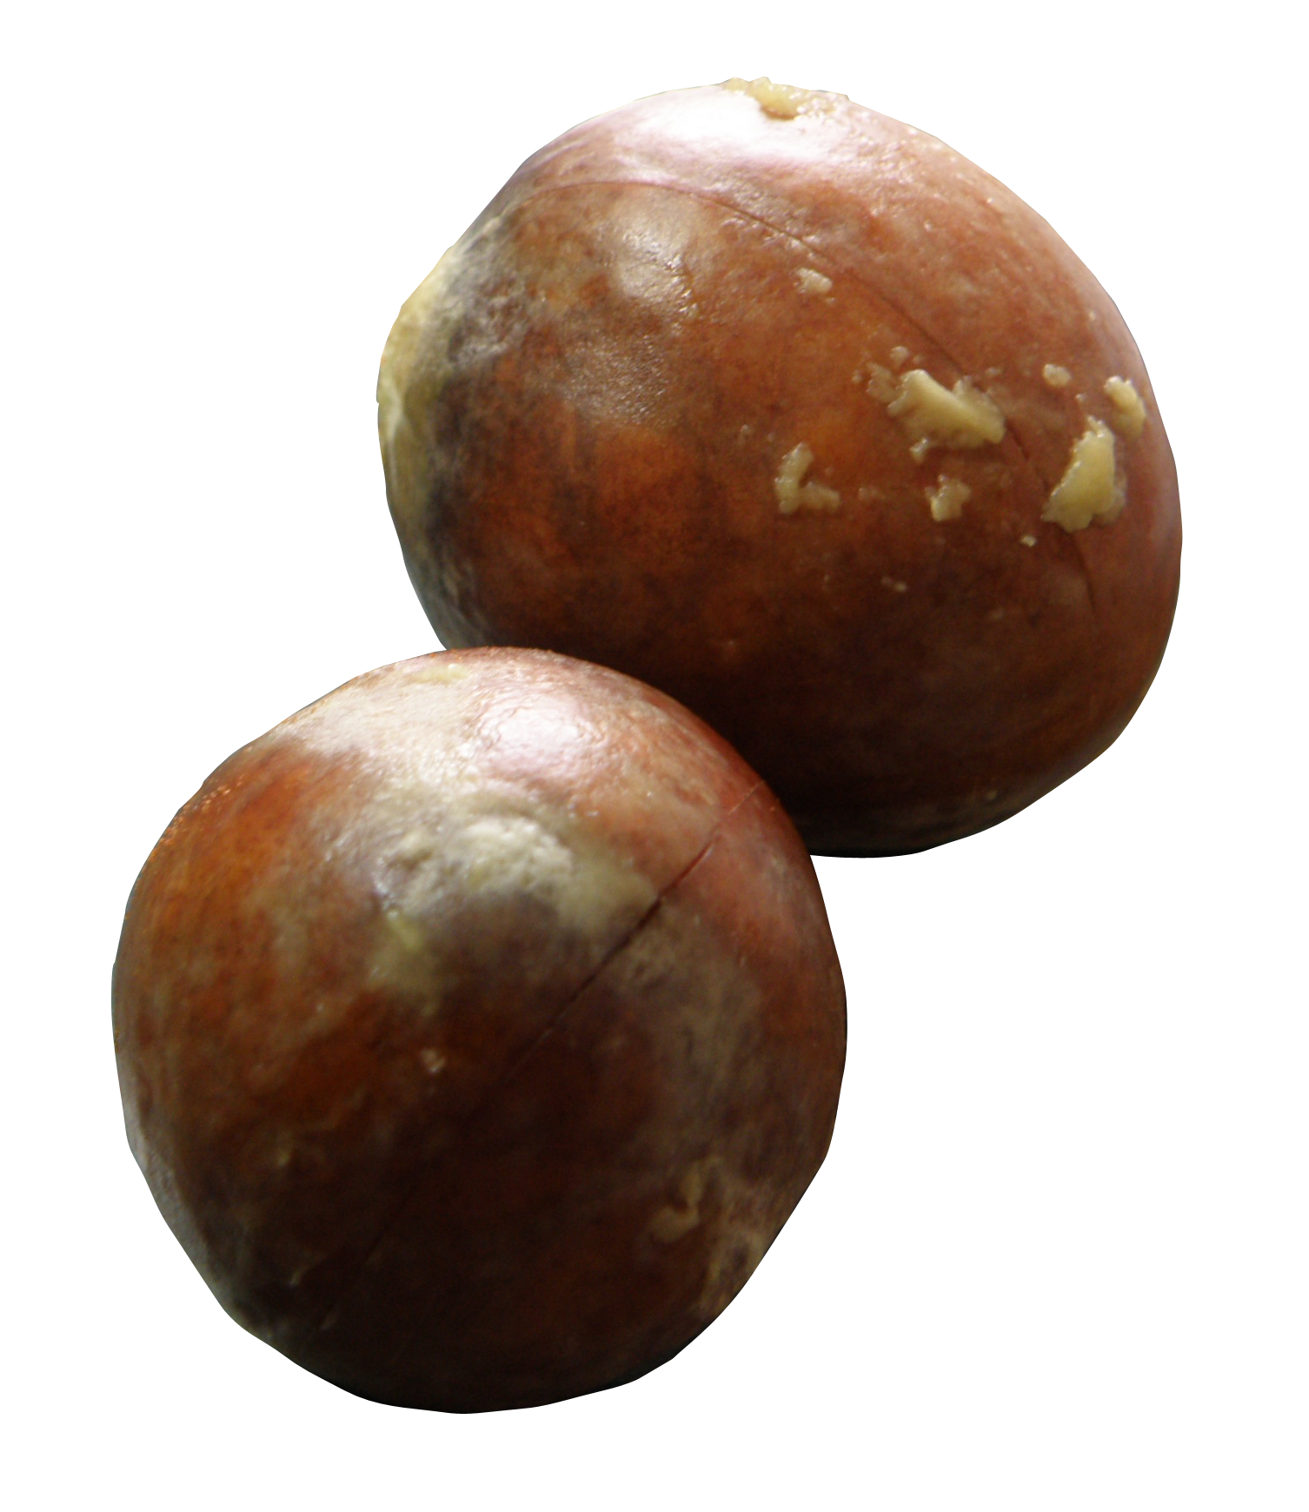
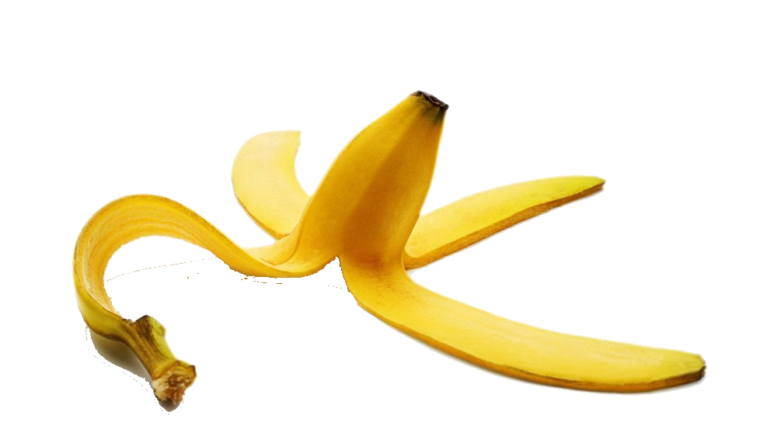
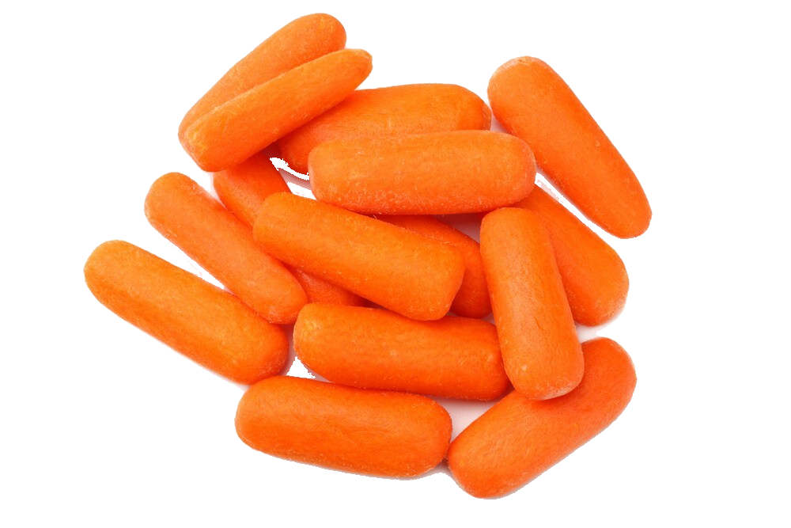
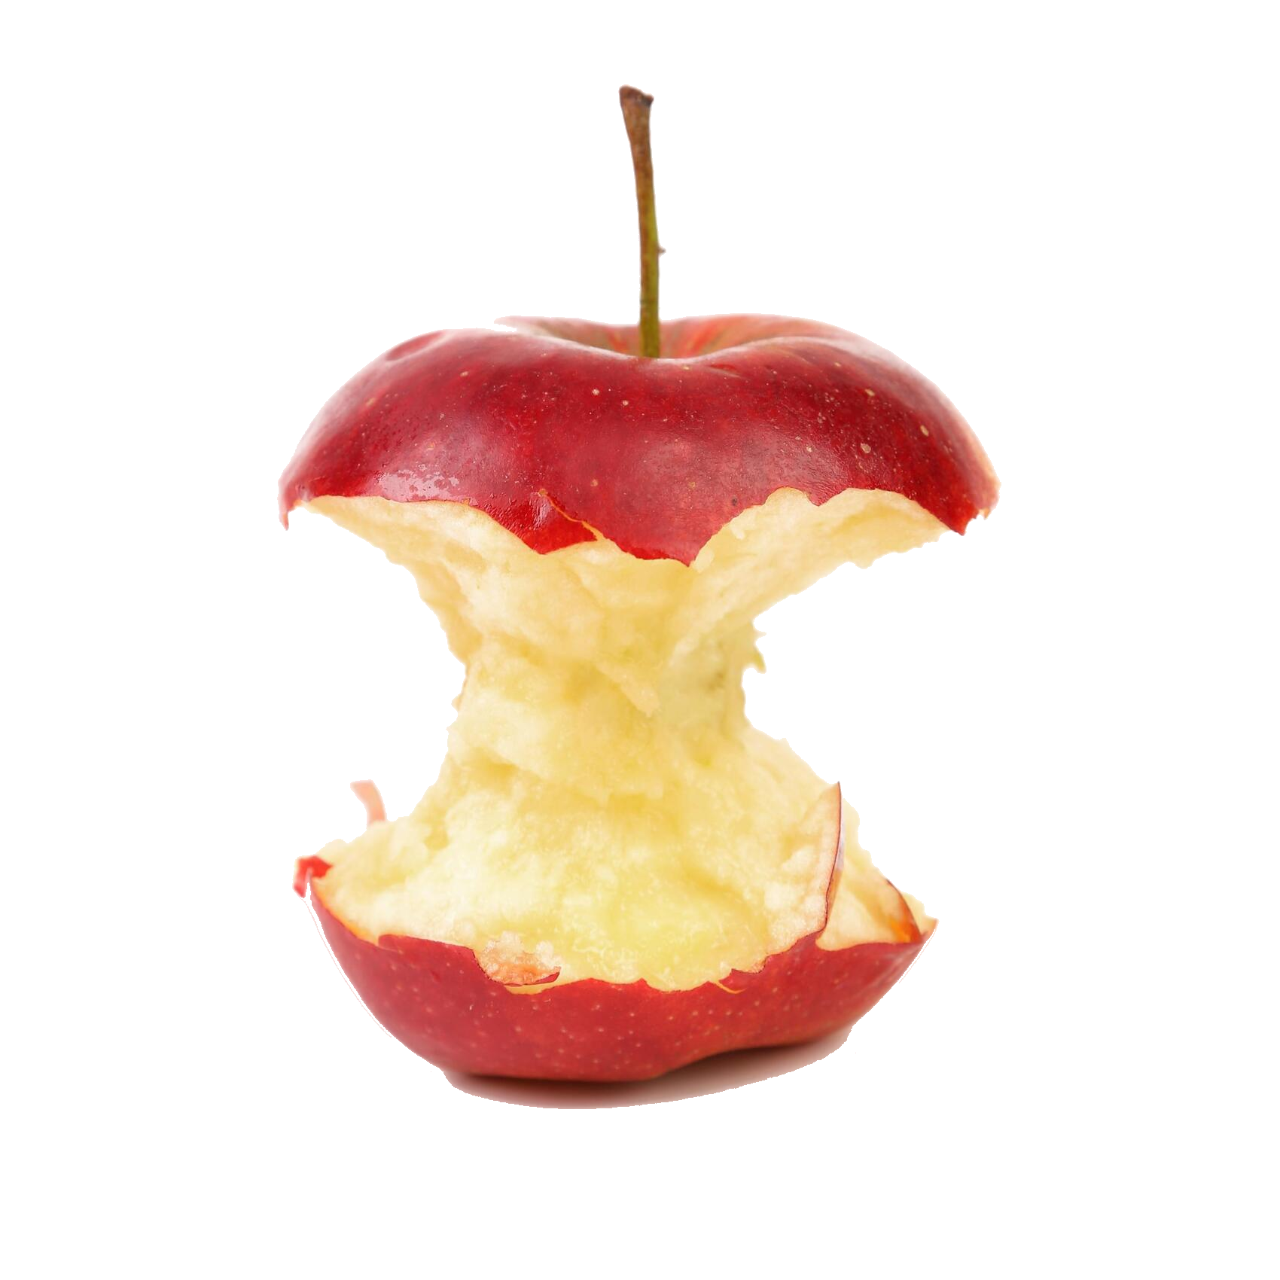
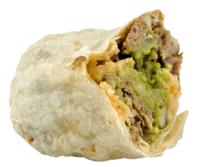
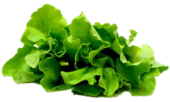
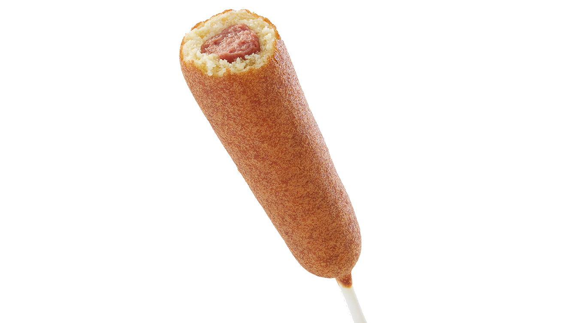
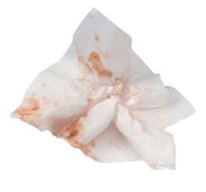
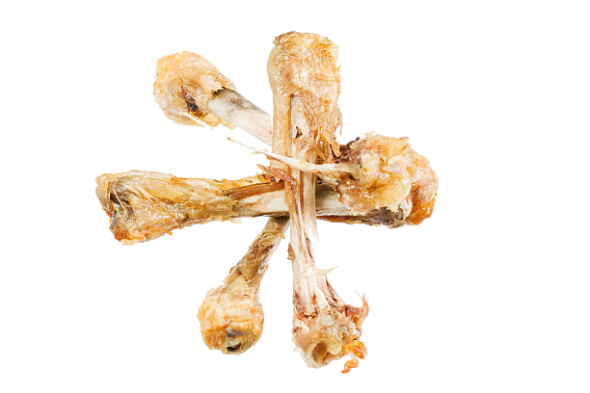
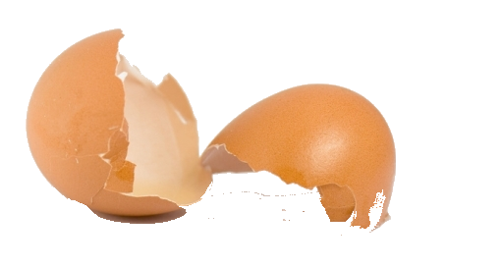
Step 4: Food Scraps in GREEN CAN
Peels & seeds
Fruits & Veggies
Leftover Food
Food Waste
Napkins & Paper Towels
Meat, bones, & shells
Notes:
Step 4– Toss leftovers or pieces that came from your food into the GREEN can. This includes:
Leftover cooked meals (point out that the stick from a hotdog can be composted)
Fruits & veggies, including the non edible parts, such as…
Peels & seeds (banana peels & avocado seeds)
Meat, bones, and shells
And even food-soiled paper like dirty napkins
Before throwing away your food waste, make sure to remove the wrappers & packaging from your food so that you can dispose them in the gray landfill can.

Slide 13
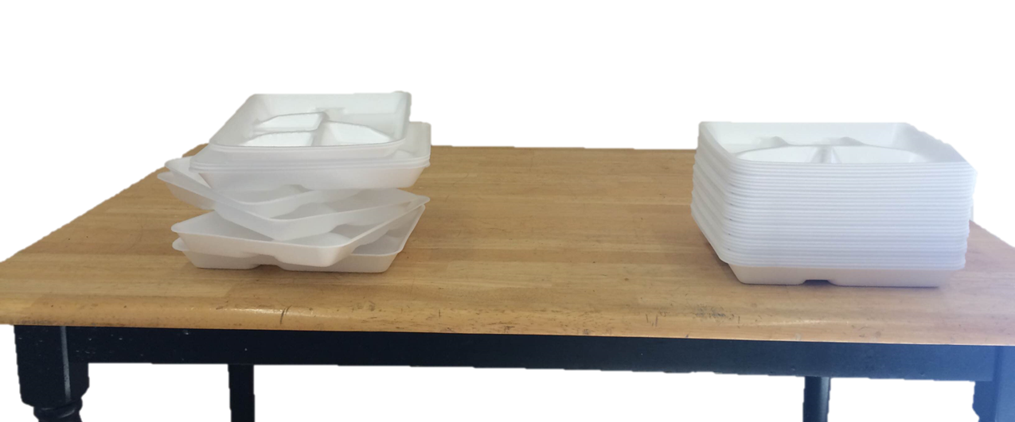
Step 5: Stack Your Tray!
No!
Yes!
Notes:
Step 2 – In general, if it isn’t food and isn’t recyclable then it will go into the GRAY can. This also includes recyclable items ONLY IF they are dirty.
Examples of trash are:
Plastic utensils & straws, filmsly plastics such as plastic wrap and zip lock bag
Milk cartons & juice boxes
Food wrappers, including sauce packets
Napkins and paper towels

Slide 14
Waste sorting game
Food Scraps
Landfill
Recycle
1
2
3
Notes:
Your school wants to help fight food waste and reduce waste in landfills by starting a food waste recycling program.
In the cafeteria, you will see new cans called “Waste Stations” to sort you waste into different containers so the food waste can be collected for compost.
The waste stations have four steps:
Liquids
Landfill
Recycle
Food Waste

Slide 15
Sort Smart & Recycle Right!
Pour liquids in the bucket
Landfill in the gray can
Clean & Dry recyclables in the blue can
Food scraps in the green can
Notes:
Don’t forget to stop, think, & sort your waste! These simple steps can make a big difference for the planet!
So remember:

Slide 16
Let’s Sort Like Crazy!
Notes:
(Optional) Now it’s time to sort your waste! Let’s watch this short video from Mr. Eco.

Slide 17
Thank You
for Listening
Katie Smet
Ksmet@sacbreathe.org
Julia Anderson
Janderson@sacbreathe.org

