Slide 1
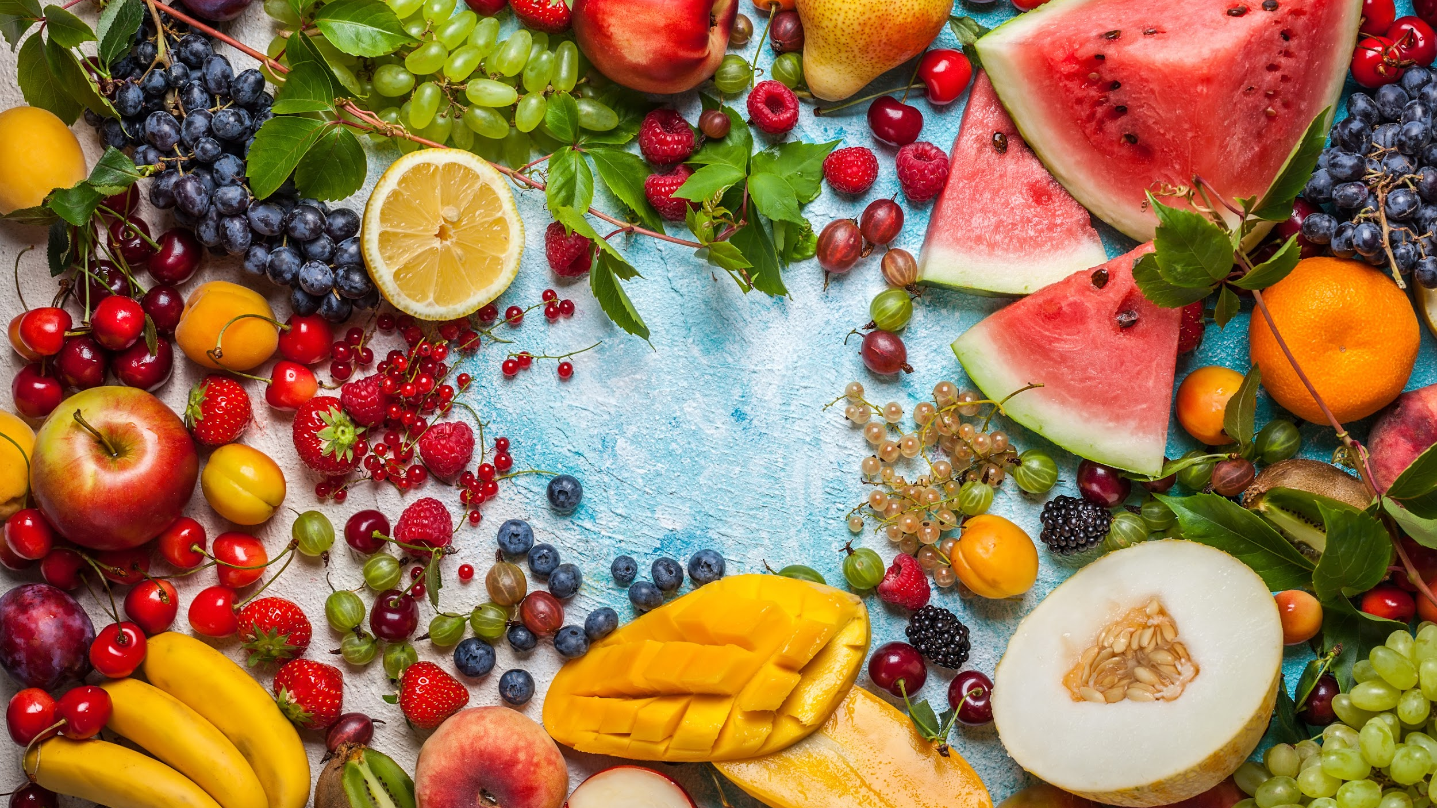
How to Sort Smart & Recycle Right!
Your school name here

Slide 2
REFLECTION QUESTION:
When was the last time you didn't finish the food on your plate?
Why?
Notes:
First, I want you to take a minute to think about when the last you threw food away on your plate. Why was the food thrown away?

Slide 3
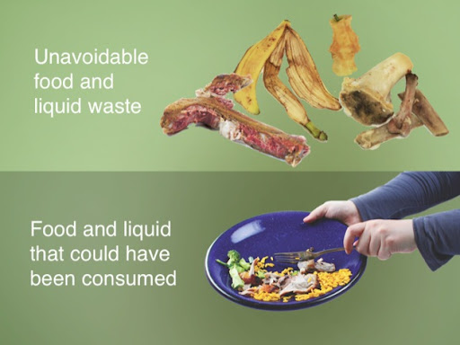
What is food waste?
Edible parts of food that are not consumed because it is discarded.
Notes:
Oftentimes, food is thrown away because we took food than we could eat or there was leftover food scraps like a banana peel or chicken bone. These are examples of food waste. Food waste is the edible and nonedible parts of food that are either discarded or left to spoil.
There are two types of food waste that we produce at home and school: avoidable and unavoidable.
Avoidable food waste refers to food and drinks thrown away that was, at some point prior to disposal, edible. For example, throwing away leftover food from a meal, milk that was left out of the fridge too long,or blemished fruits and vegetables that didn’t get eaten. In contrast, unavoidable food waste are parts of food that are not intended for consumption, such as bones, peels, or eggshells.
The amount of food waste we create is staggering. Let’s learn why.

Slide 4
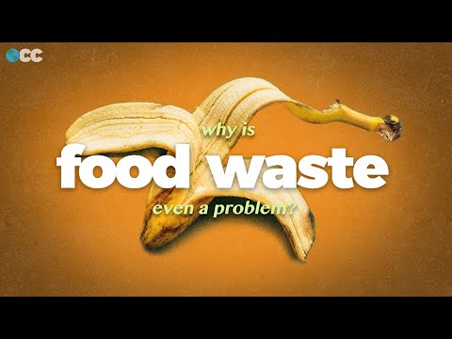
Stop video @ 1:57

Slide 5
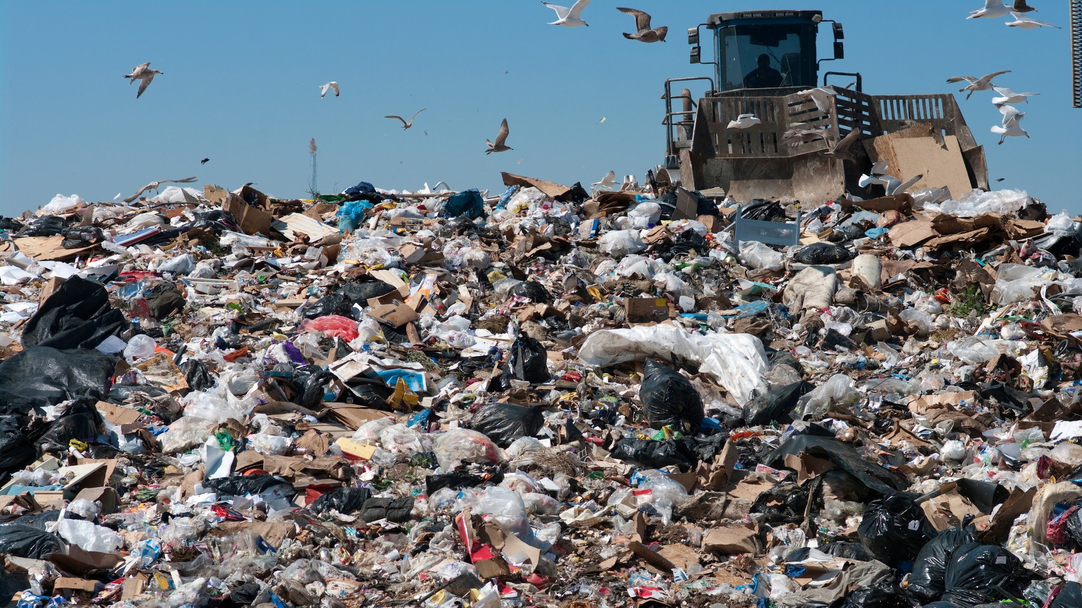
Landfill
18% of material in California landfills is food waste.
Rotting food releases methane, a greenhouse gas
Notes:
All of this waste food ends up in the landfill.
Food waste is the most common material found in landfills in the U.S. and accounts for 18% of the material found in California Landfills. Landfills are very compact and airtight, which means there is not a lot of oxygen inside them. Just like how oxygen is an essential ingredient to sustain life, and it’s also essential for helping our waste rot away. Because of this, it can take decades for our food waste to disappear in a landfill.
As the food waste slowly rots, it releases a greenhouse gas called Methane as it rots. Greenhouse gases trap heat in our atmosphere, and methane traps A LOT of heat, which causes climate change and global warming.

Slide 6
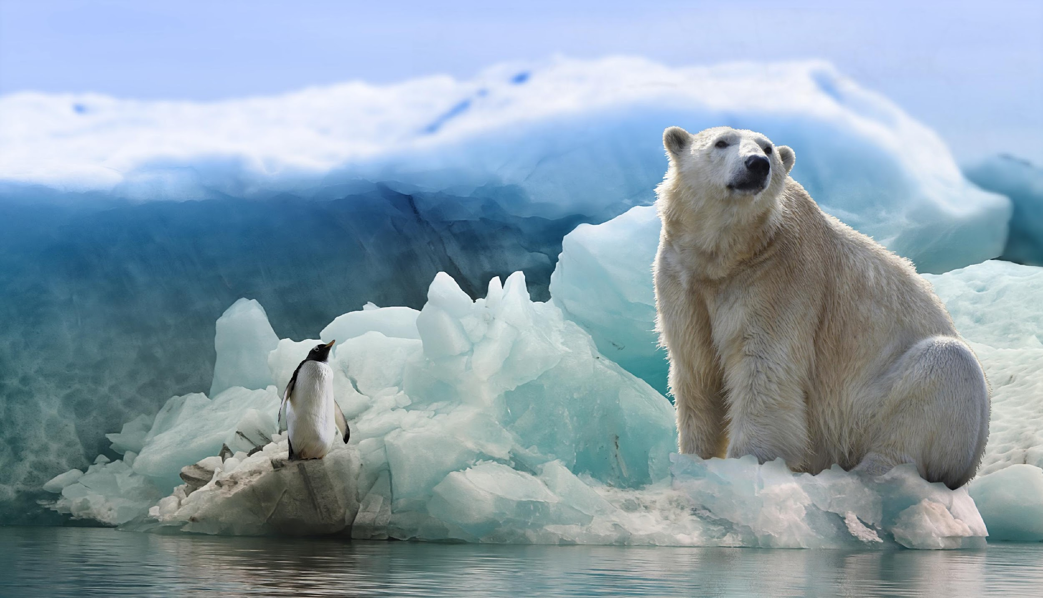
Food Waste & Climate Change
Emissions contribute to climate change:
increased droughts, floods
animals losing habitat
8% of all global emissions
Landfills are the third largest sources of Methane in California
Notes:
We need SOME greenhouse gases and are naturally occurring, like carbon dioxide… which helps keep our planet warm enough to live on. But too much is bad because this causes climate change, extreme weather events, and the sea level to rise.
Food waste accounts for 8% of the worlds global greenhouse gas emissions.
Landfills are the third largest source of methane in California.

Slide 7
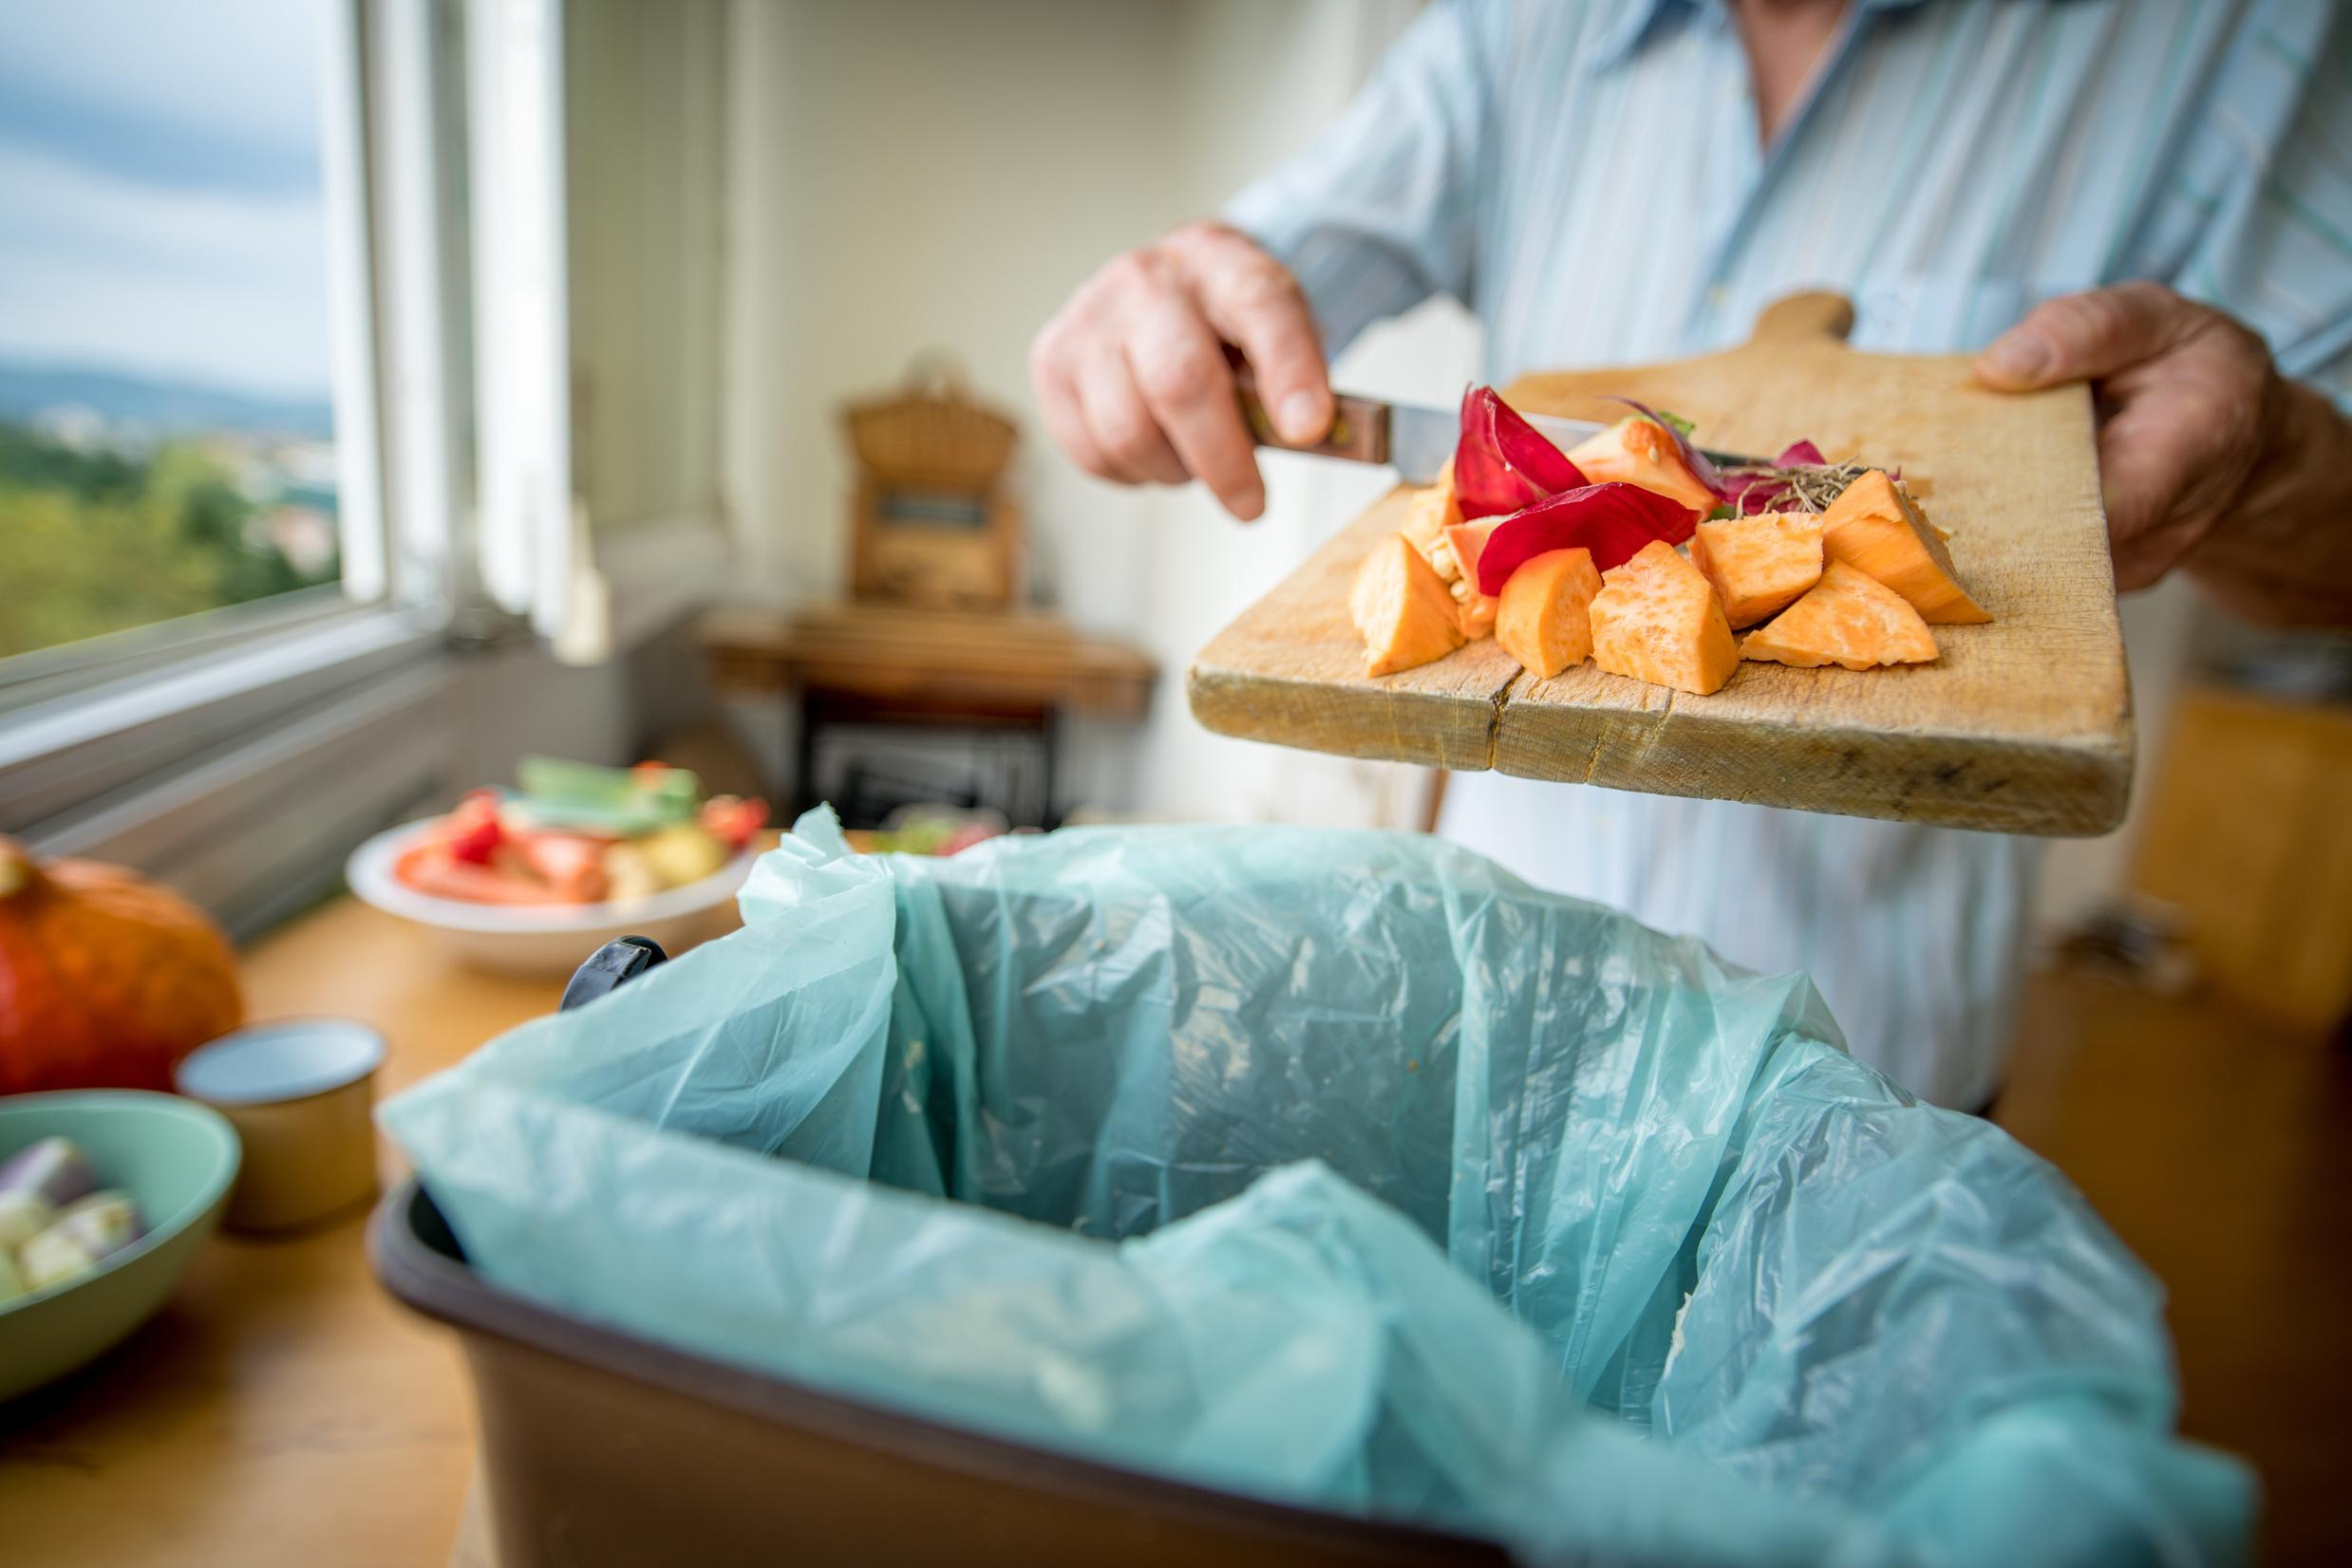
Fight Food Waste,
Fight Hunger
Food insecurity: inability to access enough healthy and nutritious food
40% of all food goes to waste
Meanwhile, 1 in 5 Californians experience food insecurity
Notes:
Each year 108 billion pounds of food is wasted in the U.S. With so much food waste, there should be no hunger, right? We have so much to spare! Unfortunately, while 30-40% of food goes to waste, filling up our landfills and warming the atmosphere, one out of five Californians lives in a “food insecure” household. The USDA defines food insecurity as a lack of consistent access to enough food for an active, healthy life. More than 11 million of those facing food insecurity are children. And because of the coronavirus pandemic, projections show that 18 million children could face hunger this year.

Slide 8
What we can do with food instead of sending it to the landfill:
Feed Yourself
2. Save for Later
3. Feed the Soil
Notes:
This food recovery hierarchy illustrates steps we can take prevent food waste. The top of the triangle represents strategies that are most preferred, down to the least preferred at the bottom.
Feed yourself, by only taking food you know you will eat and saving leftovers
Feed others, by sharing unopened and uneaten food with peers
Feed the soil, by recycling food waste into compost

Slide 9
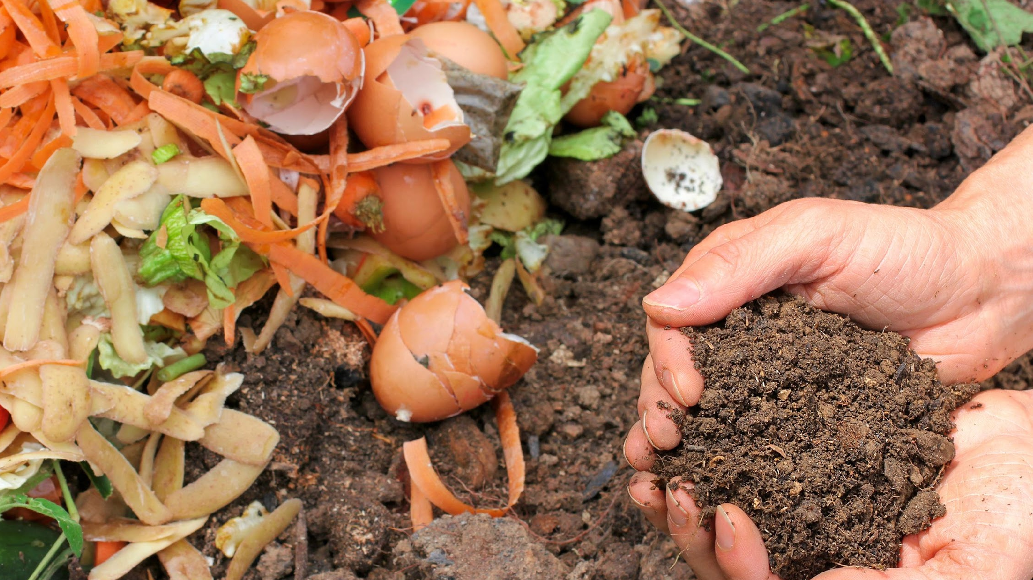
Feed the Soil with...
Compost!
Compost helps:
Create healthy soil
Divert waste from landfills
Eliminate greenhouse gas emissions
Notes:
What’s compost?
Instead of throwing food waste into the trash can, it can go into a different can to be sent to a compost pile. As the food in a compost pile breaks down with help from tiny critters, like worms, the nutrients from the food is recycled into an excellent fertilizer for gardens. Just like how humans need water and nutrients to live, our soil does too! We can use compost to feed the soil so we can keep growing food to eat!
Composting our food waste helps us reduce our waste in landfills, reduce greenhouse gases in the air, and helps us create healthy soil for gardens!

Slide 10
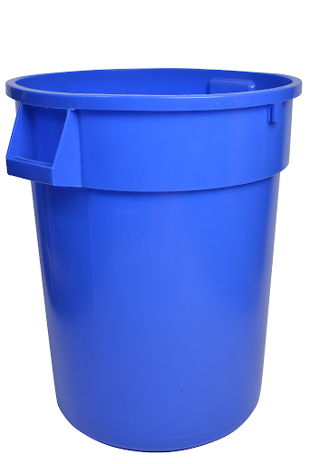
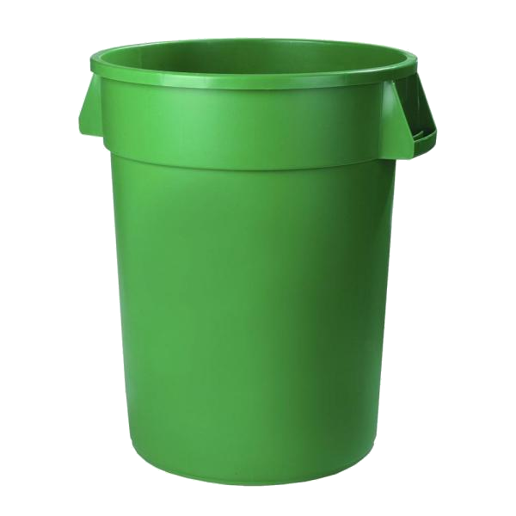
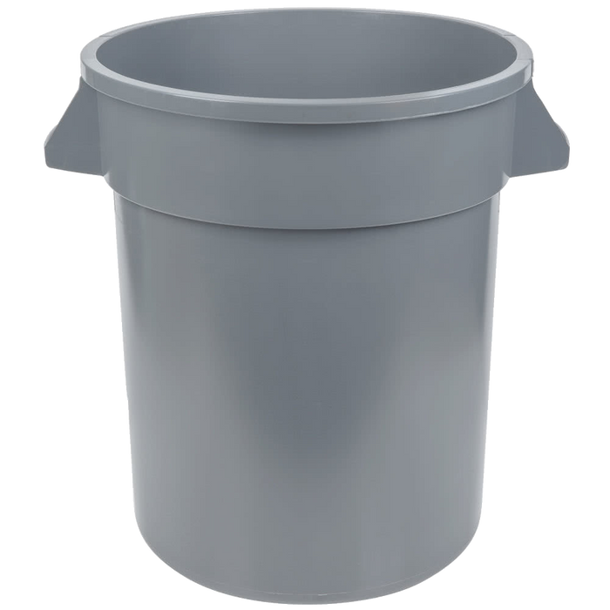
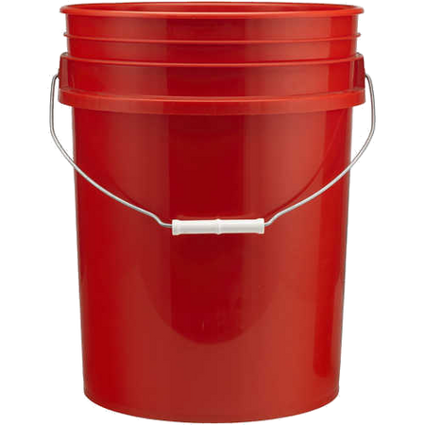
Five Steps to Sort Smart:
Food Scraps
Landfill
Recycle
Liquids
1
2
3
4
Notes:
Your school wants to help fight food waste and reduce waste in landfills by starting a food waste recycling program.
In the cafeteria, you will see new cans called “Waste Stations” to sort you waste into different containers so the food waste can be collected for compost.
The waste stations have five steps:
Food Share
Liquids
Landfill
Recycle
Food Waste

Slide 11
Step 1: Empty Liquids
Open containers ONLY
Notes:
Step 1 - Empty your liquids into the bucket.

Slide 12
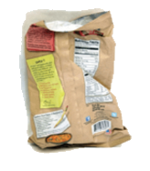
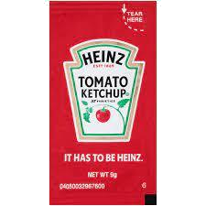
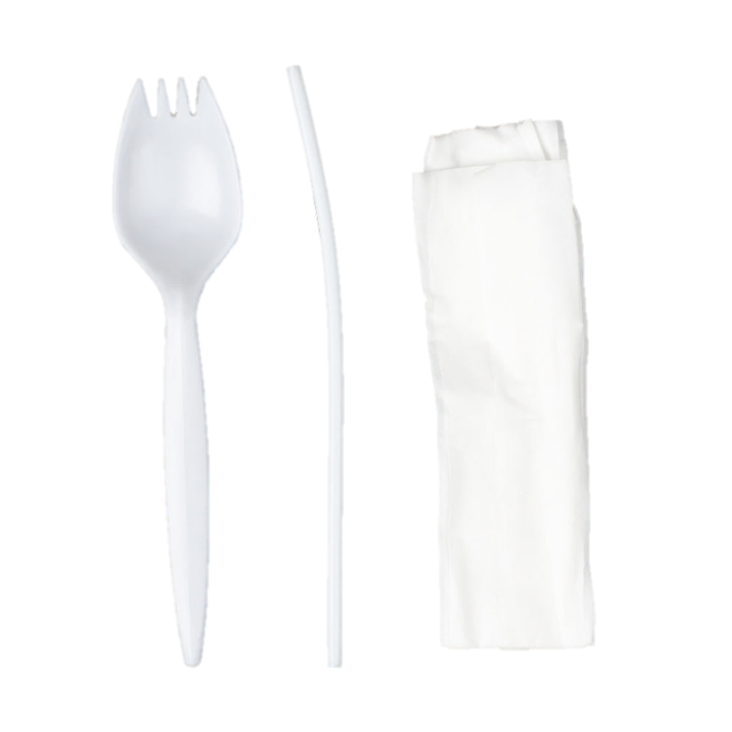
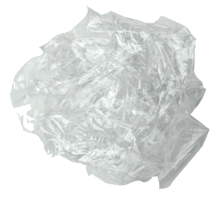
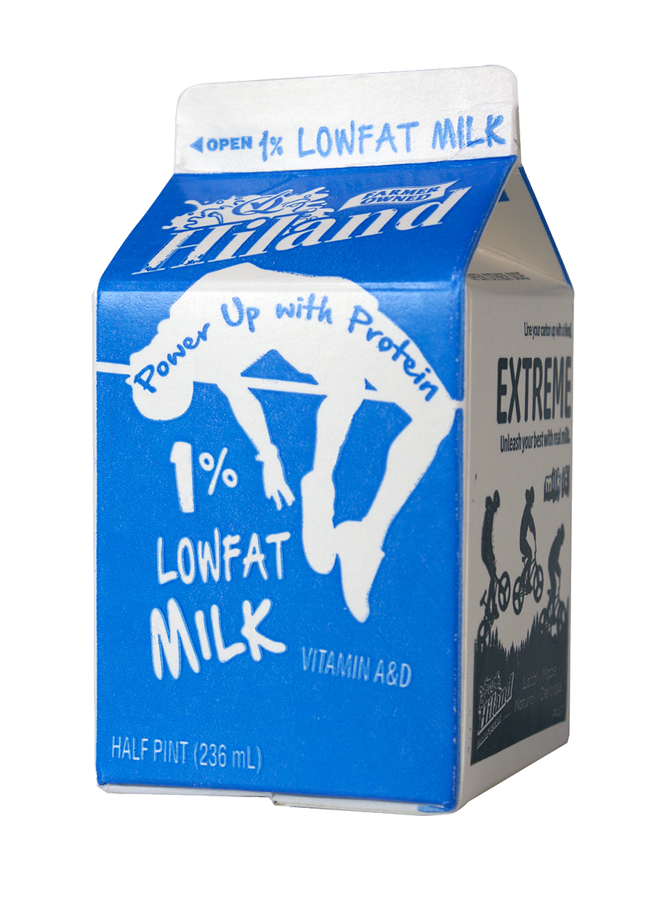
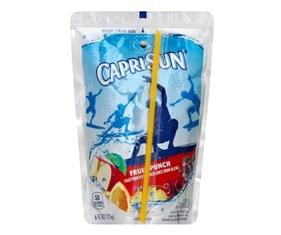
Step 2: Landfill Waste in GRAY CAN
Food Wrappers
Plastic Fork/Spoon, Flimsy Plastics
Landfill
Milk & Juice Cartons
Notes:
Step 2 – In general, if it isn’t food and isn’t recyclable then it will go into the GRAY can. This also includes recyclable items ONLY IF they are dirty.
Examples of trash are:
Plastic utensils & straws, filmsly plastics such as plastic wrap and zip lock bag
Milk cartons & juice boxes
Food wrappers, including sauce packets
Napkins and paper towels

Slide 13
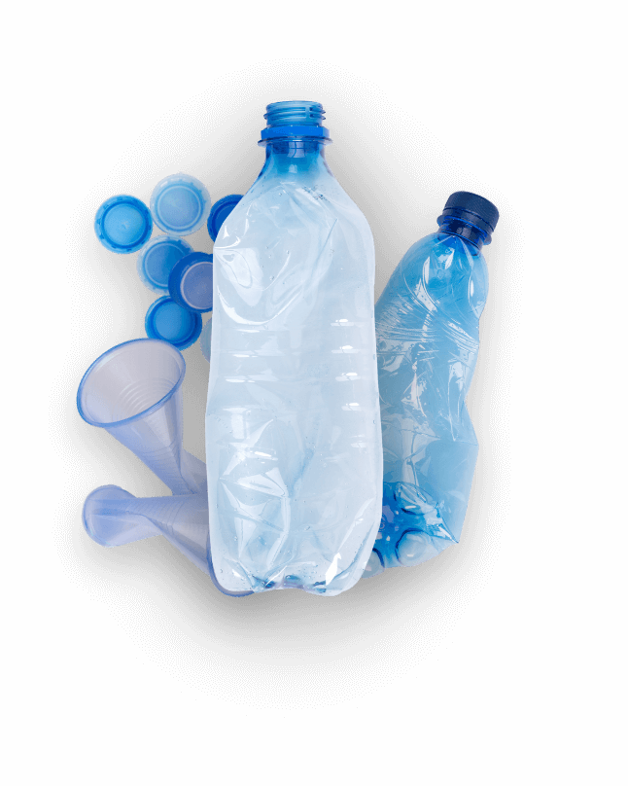
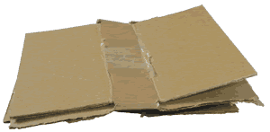
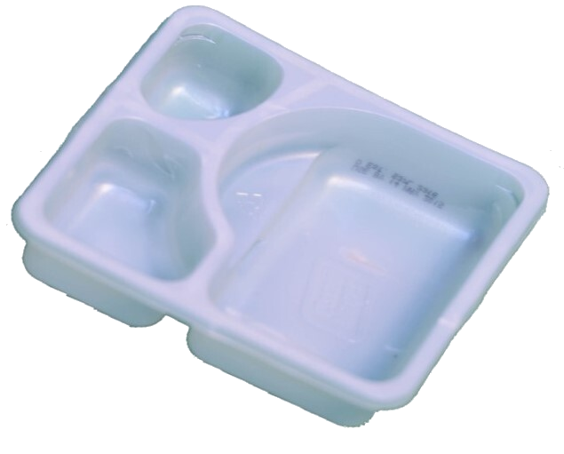
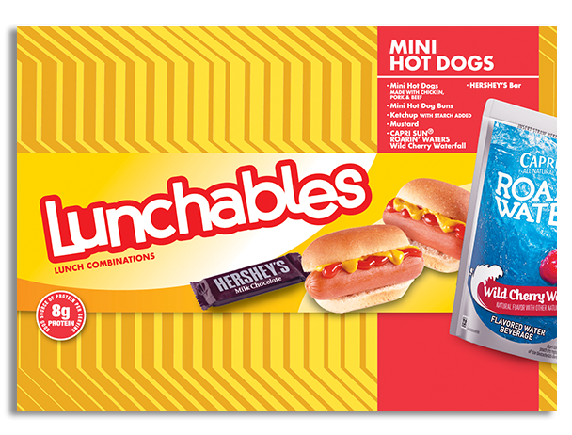
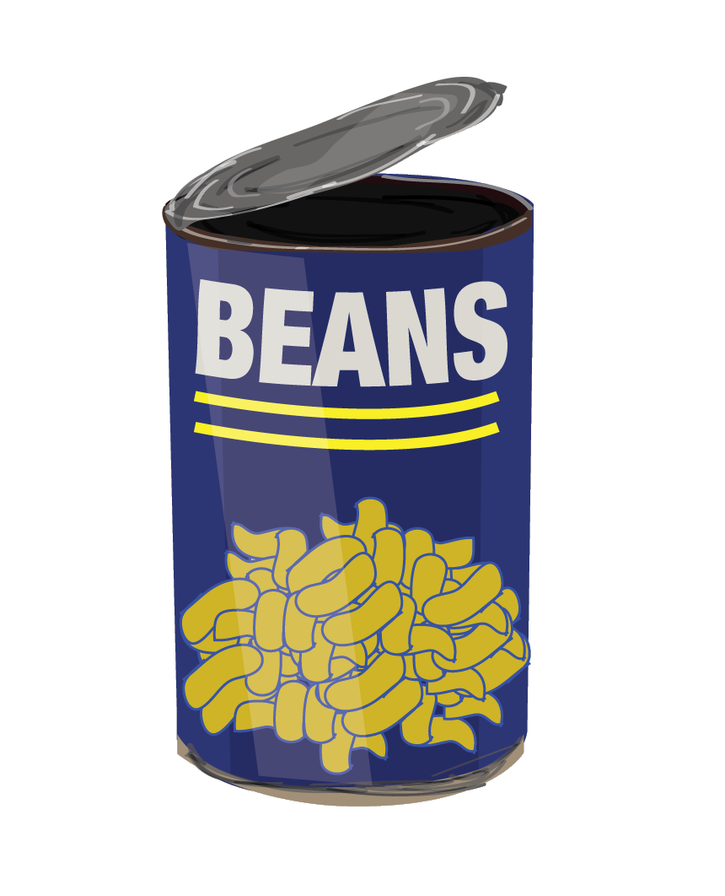
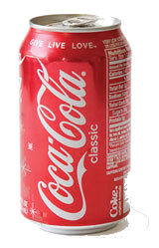
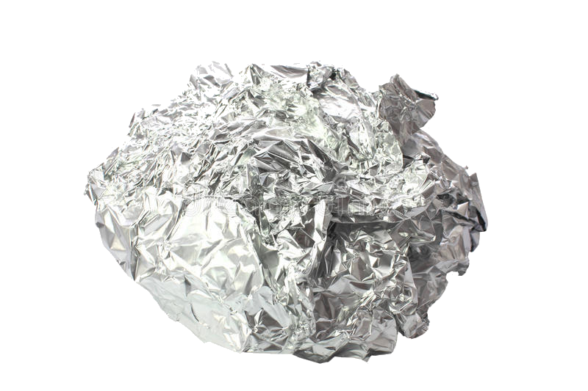
Step 3: Recycling in BLUE CAN
Clean & Dry
Firm Plastics
Clean Cardboard
Recycle
Aluminum & Metals
Notes:
Step 3 – Toss recyclables in the BLUE can. This includes clean items like:
CLEAN cardboard (such as a lunchbox)
Clean aluminum & metals Empty plastic water bottles
Clean and firm plastics (if the plastic is hard and cannot be torn easily, it can go into the recycling can)

Slide 14
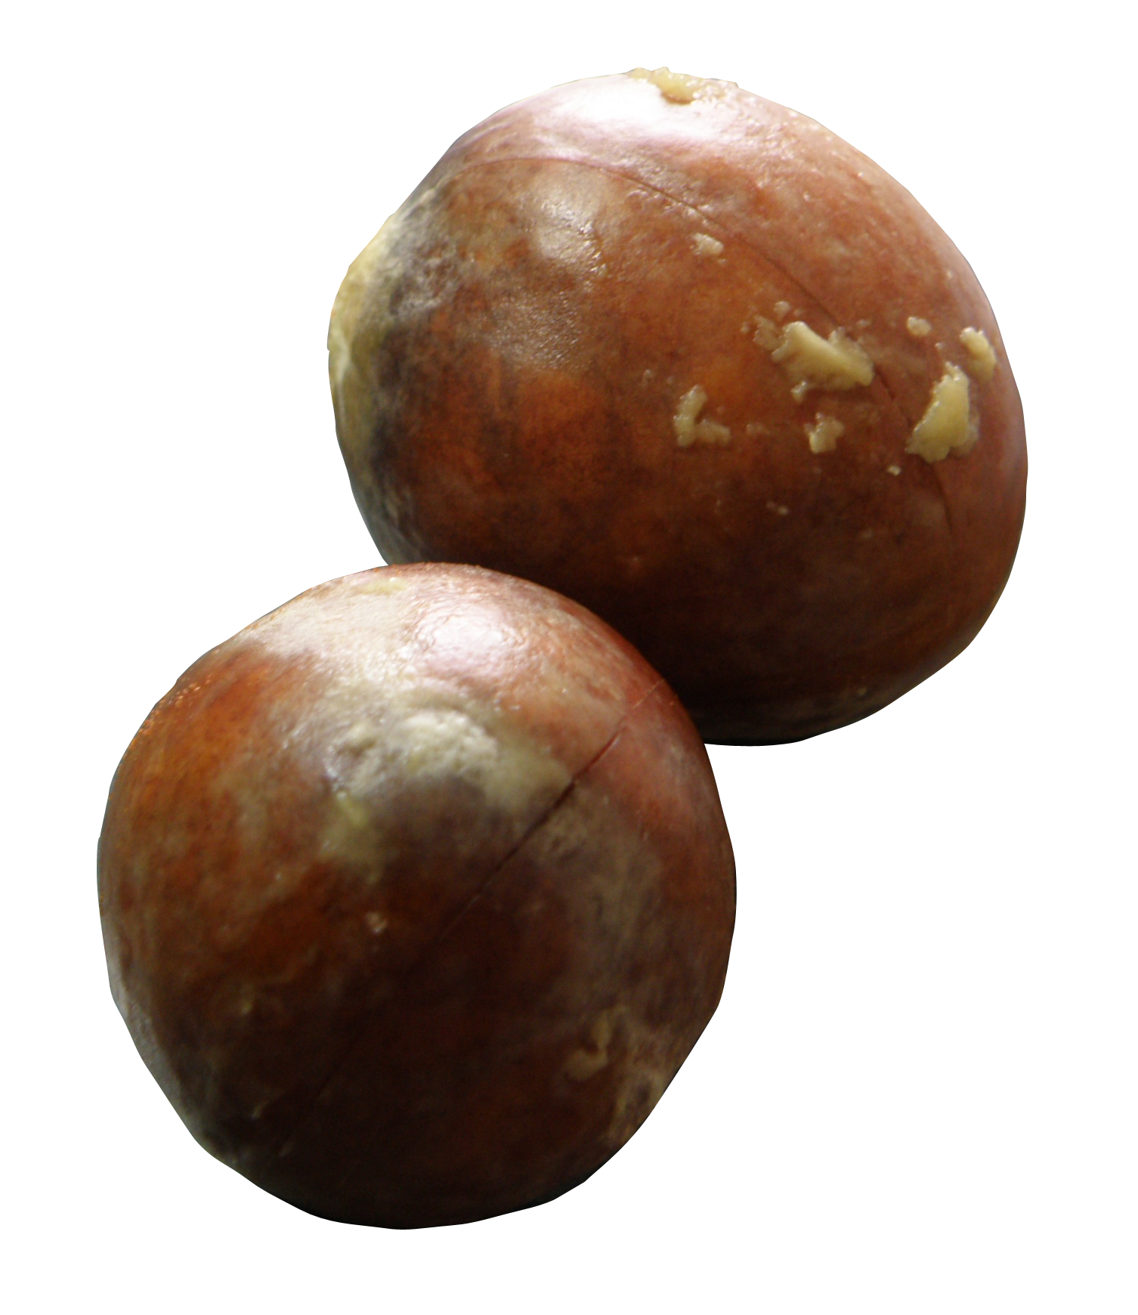
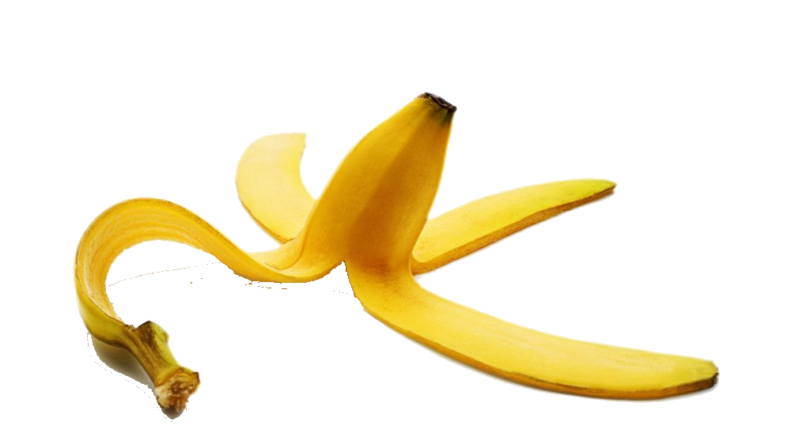
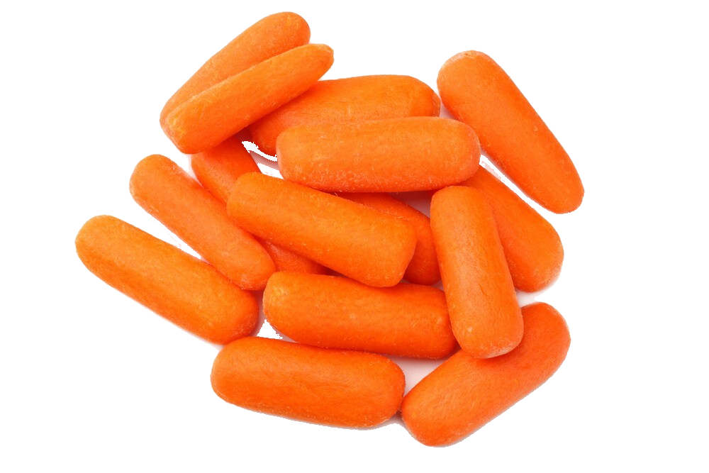
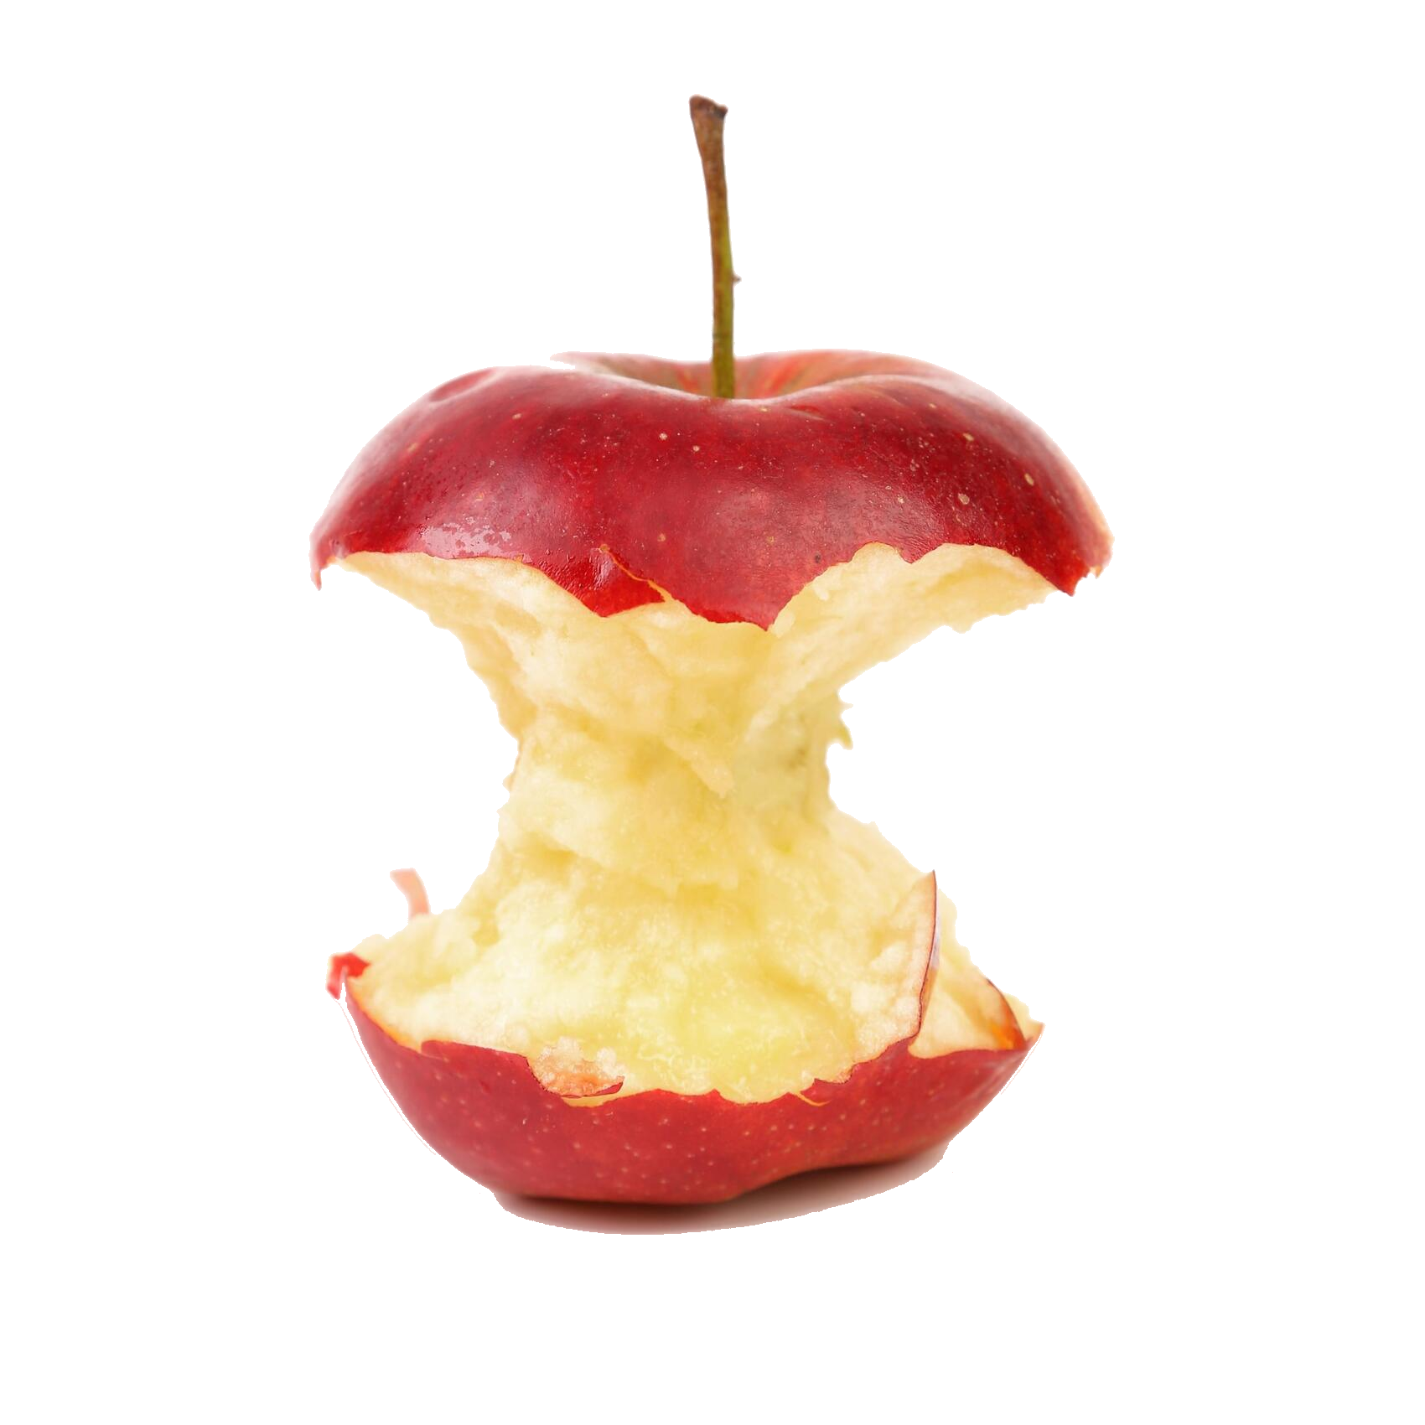
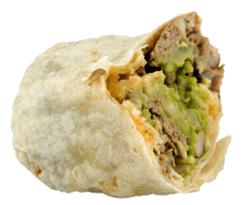
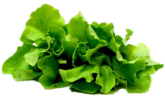
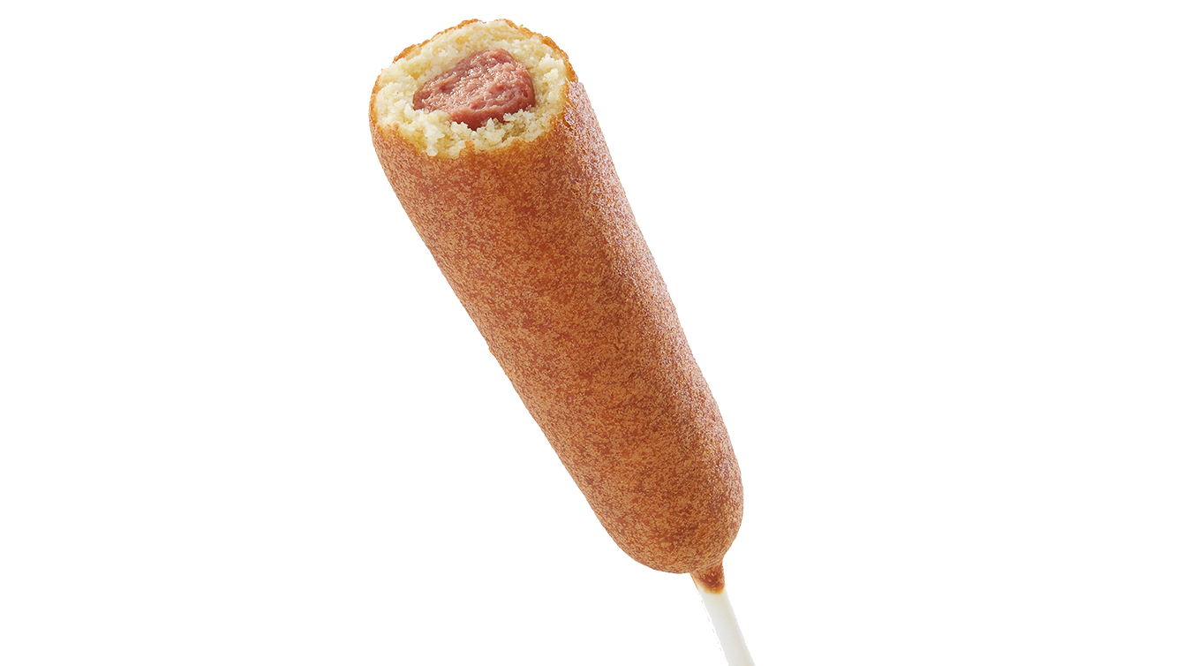
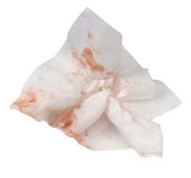
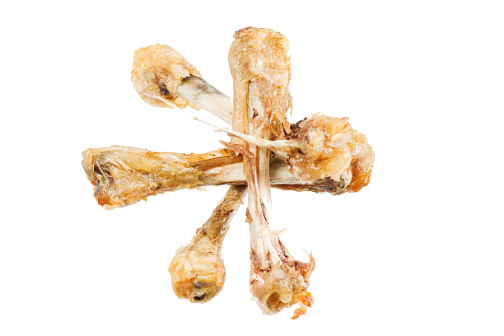
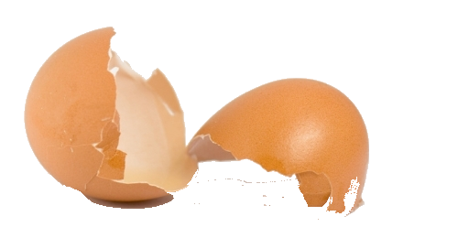
Step 4: Food Scraps in GREEN CAN
Peels & seeds
Fruits & Veggies
Leftover Food
Food Waste
Napkins & Paper Towels
Meat, bones, & shells
Notes:
Step 4– Toss leftovers or pieces that came from your food into the GREEN can. This includes:
Leftover cooked meals (point out that the stick from a hotdog can be composted)
Fruits & veggies, including the non edible parts, such as…
Peels & seeds (banana peels & avocado seeds)
Meat, bones, and shells
And even food-soiled paper like dirty napkins
Before throwing away your food waste, make sure to remove the wrappers & packaging from your food so that you can dispose them in the gray landfill can.

Slide 15
Call To Action
Sorting your waste correctly can make a HUGE difference!
Help reduce waste in landfills and protect our air by practicing these simple steps:
Take what you can eat
Save your food for later when possible
Sort smart and recycle right!

